Slide 1
CIO Council Obsolescence Update
Jan 2023
TRC Meeting Material and Minutes : http://go/trc
FAQ and Process Documents: http://go/og

Slide 2
Obsolescence overview
Progress on Obsolescence was made in 2022 but overall we’re just “treading water”
Key 2023 Focus Areas - Obsolescence Governance/Management:
Risk Committees - papers on obsolescence presented to GNFRC in Oct 2022. Further papers scheduled for TTO-NFRC, GNFRC and GRC in Q1 2023.
Obsolescence Risk – in Q1 2023, Line of Business (“LOB”) Risk Assessment & Treatment Plans will be finalised - reflecting the fact that the Bank will need to live with an “acceptable” level of obsolescence
Metrics and Reporting - phasing out old metrics (e.g. EOS KRI) and moving to new metrics (TDR/CTDR) based on Service Now starting Feb 2023. Critical Tech Debt Ratio (CTDR) will become the new Board Risk Appetite Metric (to be operationalised in H1).
Regulatory – increasingly granular updates to Regulators (e.g. PRA, MAS, HKMA, RBI). Submissions will be compared against previous submissions!
Operational resilience – SS1/21 (requires all IBS to be within impact tolerance for Operational Resilience by end Mar 2025)
Alignment with Zeus – e.g. better management of obsolescence remediation dates. Tracking of remediation dates is moving from OMS (LEAP) to Service Now strategically (with an interim solution needed in the meantime)
Audit – close four audit points in H1 2023: Risk, Strategy, Metrics and Scope
TTO PU Simplification – as part of IT Configuration, License, Refresh & Asset Management
2023 TTO-wide Focus areas (as described in GNFRC paper)
Achieving greater control of obsolescence and the risks associated requires:
Greater focus on ‘critical’ obsolescence including focused remediation and associated funding to address known critical obsolescence.
Greater use of change freezes on hosts with critical obsolete products (e.g. Win 2012)
Implementation of the technology strategy of simplification to reduce complexity (and in turn obsolescence) and drive down costs.
Commitment going forward in 2024+ to allocate a proportion of funding to Business-as-Usual (“BAU”) maintenance of existing systems.
Obsolescence Governance team manage all data relating to Technology Obsolescence across the Bank. This includes identification, risk management and remediation across all business lines/geographies/products as well as managing regulators and other third parties as needed.

Slide 3
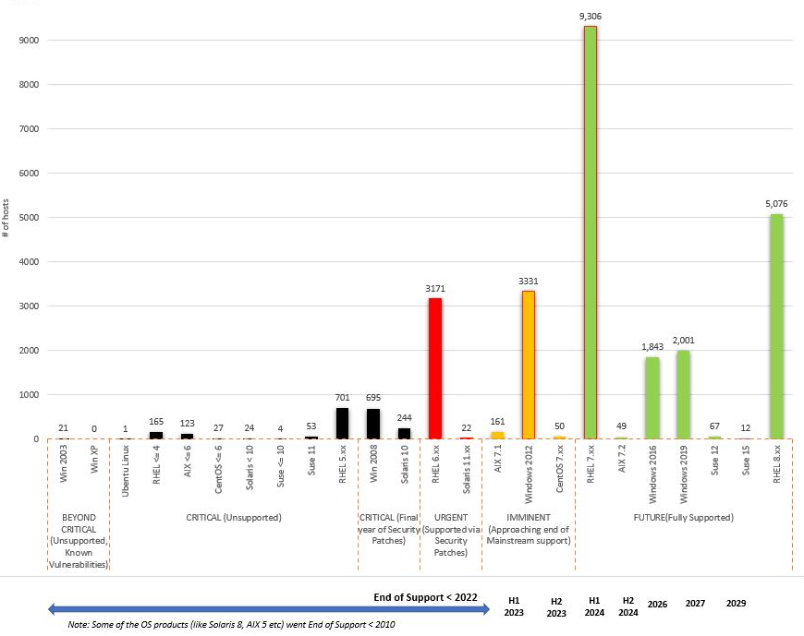
Obsolescence Status Update (Jan 2023)
Macro View
Whilst progress has been made 2019-2022, the remediation velocity can’t keep up with incremental YOY obsolescence.
In 2023/2024 an additional 47% of the estate becomes obsolete (Win2012 and RHEL 7) – see right.
Cost to remediate obsolescence increased between Jan 2022 (USD288m) and Jan 2023 (USD408m) due to declining funding for remediation.
The technology estate has been growing resulting in unsustainable complexity and cost (including obsolescence remediation cost). What is needed is:
Focus on ‘critical’ obsolescence.
Controls such as change freezes on obsolete hosts.
Implementation of simplification strategy.
Commitment to maintain systems as part of BAU funding.
Micro View
GIA audit in 2022 found 4 issues of which 3 rated ‘high’. The Action Plans span the whole organization: all CIO teams, country and group OR teams.
Risk assessments for all obsolescence due by end Jan 2023.
Replacement of GRAM (EOS KRI) in H1 with CTDR (next slides).
Complex migration from Remedy to ServiceNow in H1; DQ issues to resolve; re-creation of analytics and reports; Obsolescence Management System replacement.
Scope of coverage has increased in 2022 (+HSM) and will increase further in 2023+ facilitated by ServiceNow.
Windows 2012 (obsolete in 2023)
+ RedHat Linux 7 (obsolete in 2024)
Together: 47%
Already obsolete (19%)

Slide 4
Obsolescence Governance Roadmap (2023)
Q4 2022 | Q1 2023 | Q2 2023 | Q3 2023
OG team drives data quality improvement in ServiceNow for hardware. OG team seeks consensus to address software data quality in ServiceNow. | OG team continues to push for data quality improvement in ServiceNow for software. January YE 2022 reporting MAS: Annual report of CMDB inventory and obsolescence RBI: Quarterly obsolescence reporting Initiate reporting migration to ServiceNow; transition to “host” as unit of measure Obsolescence Management System replacement starts GIA Issue 1 action plans due (TTO risk assessment & treatment plans) February and March EOS KRI reporting stops because no available data source (Remedy / ServiceNow) with sufficient data quality >> impact to M7 reporting, to HKMA commitments and to HK Board reporting. Report initial CTDR numbers Hardware and OS reporting starts from ServiceNow. | 31 May: GIA issue 2 (Tech strategy for obsolescence risk) due for closure. [action on Ben Issa] Formal reporting of CTDR metric starts in M7 Multiple activities with dependencies on ServiceNow data readiness: April: RBI: Quarterly obsolescence reporting Resumption of tracking of software “full stack” obsolescence Resumption of full obsolescence reporting including EOS KRI needed by HK Board Resumption of HK MIBS reporting (commitment to HKMA following Monitorship) 30 June: GIA Issue 3 target date to revise metrics including GRAM (EOS KRI to change to CTDR). | EOS KRI decommissioning to start Expand scope of TDR and CTDR metrics to include additional asset types where possible (to be reviewed as part of annual procedure to assess asset types).
Further into the future: PRA SS1/21 requires all IBS to be within impact tolerance for Operational Resilience by end Mar 2025. This includes completing obsolescence remediation wherever obsolescence impacts operational resilience.

Slide 5
Critical Technical Debt Ratio (CTDR) in more detail
CTDR will replace EOS KRI as the main metric for obsolescence group wide.
Metric Description | Percentage of hosts that have critical obsolescence
Definition of “Critical” | Combination of: any host with obsolete operating system; and any host with obsolete hardware and which is a critical system (defined as the high-water mark of the many current criticality rating systems, i.e. BC5, SBIA5, CJ, IBS, etc)
Asset types included | Servers, Network devices, Storage, ATM/CDM and HSM (initial scope may be reduced – this is target scope by end Q2)
Unit of measure | Reported as a percentage. Underlying unit of measure is Host (2022 obsolescence reporting focused on ‘product instance count’)
Other aspects of definition | All business applications, including apps “in pipeline” Production and DR only; excludes dev/test/UAT etc
When will it be available? | February: Underlying data (hardware and OS) available Stretch target to share initial CTDR numbers April: Start formal reporting of CTDR in M7 Q2: Future forecasting of CTDR based on remediation dates
Note: Threshold for CTDR is not yet confirmed.
The intention is that the CTDR metric is flexible and its definition can be refined and added to (e.g. additional asset types) in the future. This will be reviewed at least annually.

